Slide 1



Predicting Lyft Prices In Boston
Riya Parikh, Roshni Tandon, Dhanvi Shah, Dhruv Shastry, Nicholas Meeks

Slide 2
Agenda
01
02
03
Project Introduction
Pre - Processing
Data Visualizations
04
05
06
Dimension Reduction
Model Evaluation
Challenges & Conclusions

Slide 3

01
Project Introduction

Slide 4





Meet the Analysts
Riya Parikh
Roshni Tandon
Dhanvi Shah
Dhruv Shastry
Nicholas Meeks

Slide 5

Project Motivation
Goals:
Select something meaningful to BU students that rely on public transport and ride share apps
Understand what impacts prices, and how we can best predict them
Determine if a combination or unique model exists to best predict price
Process:
Using price, distance, time, cartype, and weather-related to build linear regression, neural networks, decision tree, and k-NN models predicting the continuous outcome variable price.

Slide 6
Dataset
Overview
Data Merging:
The Kaggle posting contained two datasets. The first with Price and Venue related rideshare data, and the second with weather-specific data for the day. We merged both.
2
Datasets
Dimension Analysis:
Together, our dataset had 22 dimensions, and after data cleaning we were left with 12
22
Dimensions
From Kaggle: “Uber and Lyft Cab Prices” by RaviMunde
Collected in mid-November to mid-December in 2018.
Tracks ride prices between popular Boston destinations
Data Completeness:
Our merged dataset had a large amount of observations, and the Uber data had more N/A variables so we kept only Lyft with
307,408 observations
693,071
Observations

Slide 7
02
Pre- Processing

Slide 8
Data Cleaning
Dropped Variables
New Variables
Variables
Explanation
‘weekday’
‘time_stamp’
‘id’
Same as the index
‘time’
‘product_id’
Similar to ‘name’ but worse
‘destination/source_temp’
‘temp’
‘cab_type’
All values equalled ‘Lyft’
‘destination/source_wind’
‘wind’
‘humidity’
Not relevant/intuitive
‘destination/source_rain’
‘rain’
‘pressure’
Not relevant/intuitive
‘destination/source_clouds’
‘clouds’

Slide 9
Final Variables
Distance
Destination
Source
Surge Multiplier
In miles
12 Destinations
12 Sources
Between 1.00 - 3.00
Name
Weekday
Time
Temp
Lyft Type
Day of the week
Microseconds past 12 am
The temperature
Clouds
Rain
Wind
Price
Cloudiness from 0 - 1
Inches in the last hour
Wind speed in mph
Prediction Variable

Slide 10
03
Data Visualizations

Slide 11
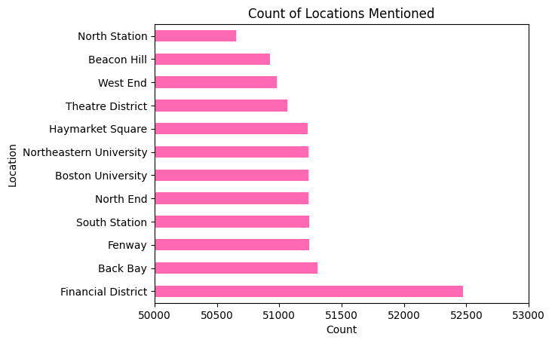
Data Visualizations

Slide 12
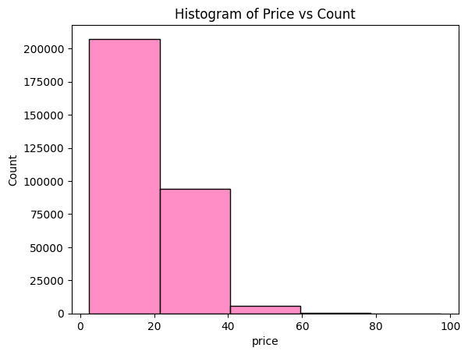
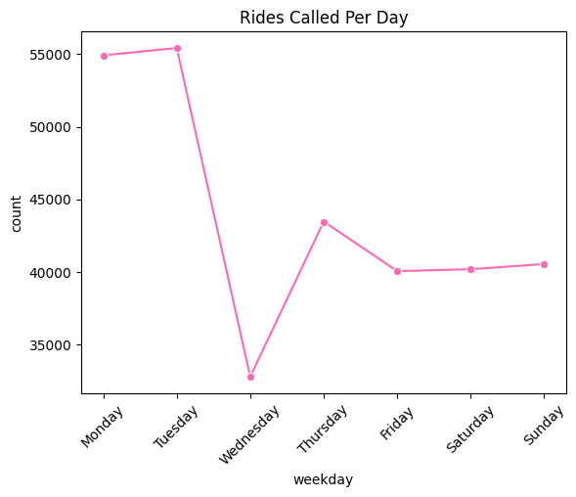
Data Visualizations

Slide 13
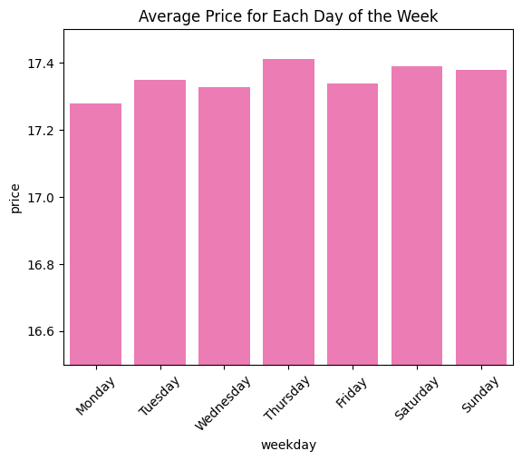
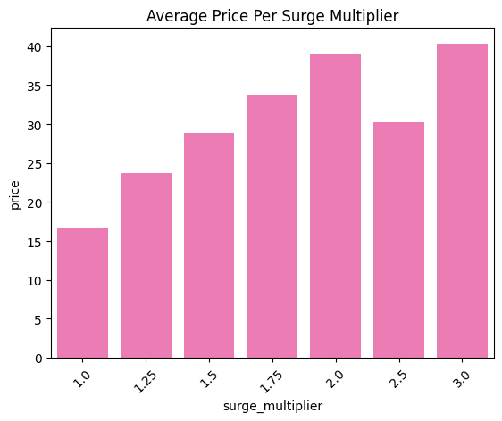
Data Visualizations

Slide 14
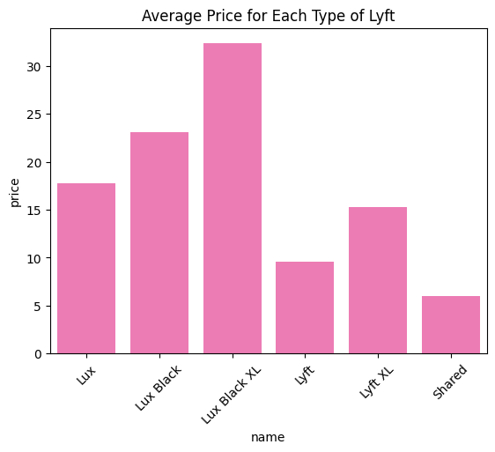
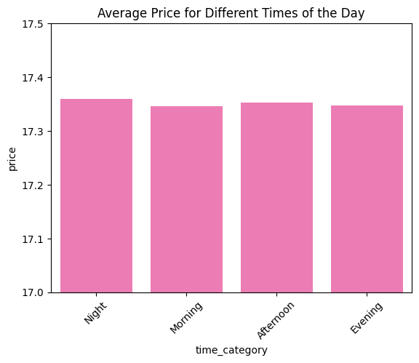
Data Visualizations

Slide 15
04
Dimension Reduction

Slide 16
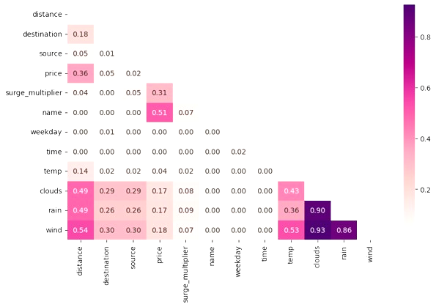
Correlation Map
Takeaways:
Weather-related variables have high correlations with each other
Price is highly correlated with name and surge_multiplier
Solution:
Run Principal Component Analysis (PCA) to reduce the dataset’s dimensionality

Slide 17
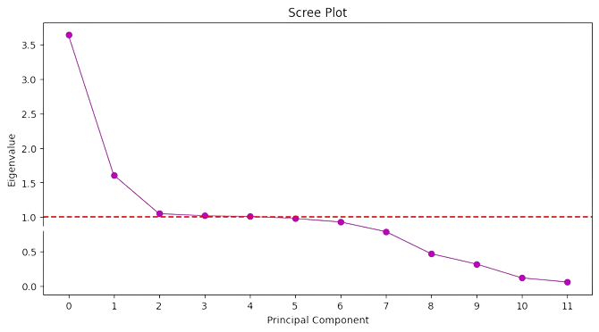
Component Number Selection
 | Proportion of Explained Variance | Cumulative Variance
1 | 0.304 | 0.304
2 | 0.134 | 0.437
3 | 0.088 | 0.525
4 | 0.085 | 0.610
5 | 0.084 | 0.695
6 | 0.082 | 0.777
7 | 0.077 | 0.854
8 | 0.066 | 0.920
9 | 0.039 | 0.959
10 | 0.026 | 0.986
11 | 0.010 | 0.995
12 | 0.005 | 1.000
The Latent Root Criterion and Explained Variance Criterion both recommend choosing five components

Slide 18
PCA Variables
Original Variables
‘clouds’
‘rain’
‘wind’
‘price’
‘surge_multiplier’
‘name’
‘distance’
‘source’
‘destination’
‘temp’
‘weekday’
‘time’
PCA Variables
‘bad_weather’
‘price_sensitivity’
‘distance_location’
‘good_temperature’
‘time_stamp’

Slide 19
05
Model Evaluation
Naive model vs Linear Regression, Neural Networks, Decision Trees, Random Forest & K-Nearest Neighbors
Notes:
Naive, lin reg, neural networks, decision trees, knn?

Slide 20
Naive Model
Finds the dataset’s average price and classifies the predicted price of every ride to the average.
Allows for a benchmark when evaluating the accuracy of subsequent predictive algorithms
Average Price: $17.35
Takeaways: The root mean squared error indicates that the Naive model is not a good approach. More importantly, it signifies a benchmark all other models must beat.
RMSE | 10.02

Slide 21
Linear Regression
PCA Data
 | Coefficients
‘bad_weather’ | 0.000164
‘distance_location’ | 0.002129
‘good_temperature’ | 0.003007
‘time_stamp’ | 0.000108
RMSE | 1.267

Slide 22
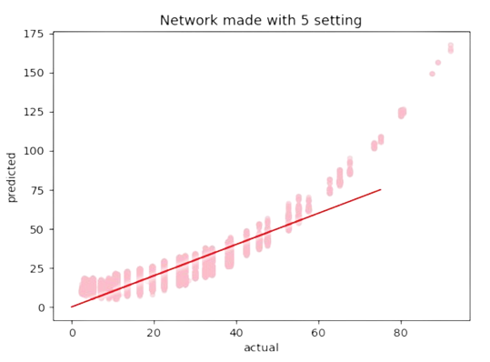
Neural Networks
Non - PCA Data
Model Specifications
RMSE
1 hidden layer with 2 nodes
6.128
1 hidden layer with 5 nodes
6.081
3 hidden layers with 2 nodes each
6.146
3 hidden layers with 5 nodes each
6.091
Construction:
We created a function that could handle arbitrarily sized neural networks.
Takeaways:
By changing the activation function and solver types in tandem with varying the number of layers and nodes, we were able to achieve higher accuracies. A better model could be created with better processing power. The model is worse at predicting prices for rides that are $60+.
Notes:
RP

Slide 23
Decision Trees
All Components
PCA Components
Model
Root Mean Squared Error
Baseline Tree
1.874
1.386
Best Grid Search
1.192
1.180
Construction:
Was done with both all and PCA components to see if an excess of variables could affect accuracy through overcomplexity and overfitting. Also experimented with grid search through hyperparameters of max depth and minimum records to split, and picked the best combination to create additional tree on. Takeaways:
Best tree occurs with grid search and PCA components: {'min_samples_split': 10, 'max_depth': 20}. Due to the the tree’s depth, it’s not great for interpretability to manually classify a new sample.
Easy for users to follow in real-world context.
Notes:
RP

Slide 24
Random Forest
All Components
PCA Components
Model
Root Mean Squared Error
Baseline Tree
1.425
1.035
Best Grid Search
1.356
1.116
Construction:
Done with both all and PCA components to see if an excess of variables could affect accuracy through overcomplexity and overfitting. Also experimented with grid search through hyperparameters of max depth and minimum records to split, and picked the best combination to create forests on. We used 1000 estimators and ran a parallelized program with 4 processors. Takeaways:
The best forest occurs without additional parameter changes and with PCA components.
The second best forest occurs with {'min_samples_split': 10, 'max_depth': 15} and PCA components.
May not be ideal because of the computing power and time required as well as lack of user-friendliness.
Notes:
RP

Slide 25
K-Nearest Neighbors
PCA Data
Construction:
We fit clusters to the price and other data provided for our training set.
We sorted our test data into these groups.
Based on the RMSE for up to 50 classification groups, k=2 is the ideal number of classifiers.
Takeaways:
These classes could be highly correlated with surge pricing.
It is possible that more classification groups could result in higher predictive accuracy.
Split | Train: 60% Test: 40%
Best # of Neighbors | 2
RMSE | 0.382

Slide 26
06
Challenges & Conclusion
Notes:
Naive, lin reg, neural networks, decision trees, knn?

Slide 27
Model
Accuracy
 | Naive Model | Linear Regression | Neural Networks | Decision Trees | Random Forest | KNN
RMSE | 10.019 | 1.267 | 6.081 | 1.180 | 1.116 | 0.382
Comparing the predictive power of the different predictive algorithms and identifying the best one

Slide 28
Limitations and Challenges
Outdated
Data
Holiday Dates
Few Hidden Layers
Quantity Demanded
The data was collected in 2018 over the span of a month
Both Thanksgiving and Black Friday were during the collected time period
With the addition of more data, and a better software we could’ve expanded on neural networks
Quantity demanded of rides is not accounted for, which impacts level of surge pricing

Slide 29

Next Steps
Inquire into additional predictive models
Incorporate data on Lyft’s demand
Implement additional locations such as Logan Airport
Investigate the impact of holidays on pricing
Include data from a large time frame spanning both months and years

Slide 30
Thanks
Do you have any questions?

